Slide 1
Capstone Project Report
The Battle of Neighborhoods
July 2021, Aymen Elouaai

Slide 2
01
Background discussion
Description of the problem
02
TABLE OF CONTENTS
Required data
04
Targeted audience
03
05
Methodology & Data Analysis
06
Discussion and conclusion

Slide 3
01
Background discussion

Slide 4
Toronto, city, capital of the province of Ontario, southeastern Canada. It is the most populous city in Canada, the fourth most populous city in North America, ranked 13th among 2020's 100 world best cities, a multicultural city, and the country’s financial and commercial center. Its location on the northwestern shore of Lake Ontario, which forms part of the border between Canada and the United States, and its access to Atlantic shipping via the St. Lawrence Seaway and to major U.S. industrial centres via the Great Lakes have enabled Toronto to become an important international trading center.

Slide 5
02
Description of the problem

Slide 6
Nathan Anderson is a Canadian chef and owner of a restaurant which serves French authentic meals. In vacation to Rabat and after giving the Moroccan cuisine a taste, Nathan got interested into the Mediterranean cuisine, Nathan thought about opening a Moroccan restaurant that serves Mediterranean meals but didn't know from where to start and he was busy, in order to buy him a lot of time he hired you, a data scientist, to do a complete analysis of opening a Moroccan restaurant in Toronto and to report back to him what places and locations may have a high potential of opening his new restaurant at.

Slide 7
03
Targeted audience

Slide 8
For this project the targeted audience could be anything from an individual willing to invest in cuisines by starting up a restaurant to a business group willing to expand their restaurants chain, or someone's interested to improve their busisiness' profitability or efficiency.

Slide 9
04
Required data

Slide 10
List of postal codes from Toronto : we need information about different boroughs and their neighborhoods in Toronto
Geographical coordinates of Toronto's neighborhoods: we will use this dataset to get information about coordinates of Toronto's neighborhoods
Other Moroccan restaurants in each neighborhood: we will use Foursquare to get venues in different neighborhoods in Toronto with Moroccan restaurants
Toronto GeoJSON file : we will use this file to create choropleth maps for Toronto using Folium
Immigration and ethnocultural diversity statistics : we will use this information to create population density choropleth maps using Folium

Slide 11
05
Methodology & Data Analysis

Slide 12
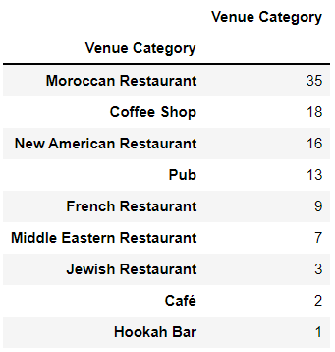
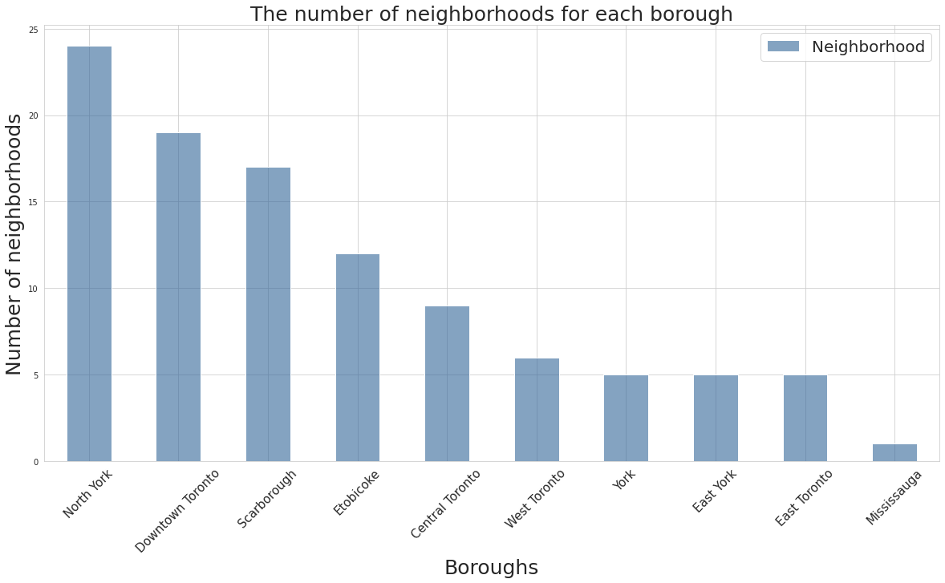
After Webscarping the postal codes of Toronto using BeautifulSoup I removed unnecessary columns such as columns with no values or unassigned values, and then combine rows with the same postal code by combining their different neighborhoods, after that I scrapped the geo-spatial dataset which was provided by Coursera and then the Toronto GeoJSON. I proceeded to define my personal Foursquare credentials in order to use theur API whcih I used when I created a function that obtains Moroccan restaurants of all neighbourhoods of Toronto and the storred all the returned data into a dataframe. Later on I loaded the neighbourhood profiles dataframe, removed data conserning non-african citizens since I won't need it, I then removed unnecessary columns and only left the Neighborhood, Neighbourhood Number and Population. And finally scrapped the business improvement areas

Slide 13
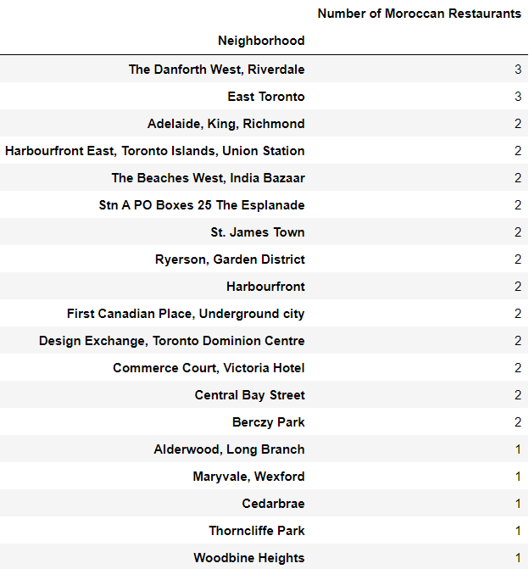
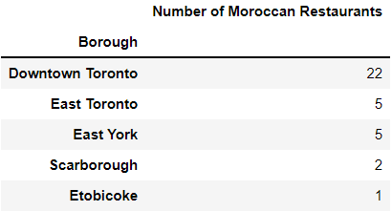
there are 35 Moroccan restaurant in Toronto, I then explored to identify which neighborhoods and which boroughs have these Moroccan restaurants to end up with these tables

Slide 14
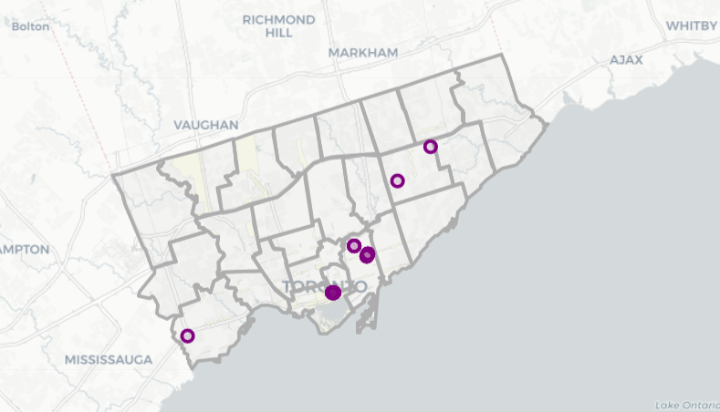
After some dataset operations I made a map that show's the concentration of these restaurants in the city of Toronto, and later on I used a machine learning algorithm and I chose DBSCAN because it’s perorm when examining spatial data, I started by preparing the data, then found the optimal Epsilon value for the DBSCAN modeling and then visualized the results.

Slide 15
06
Discussion and conclusion

Slide 16
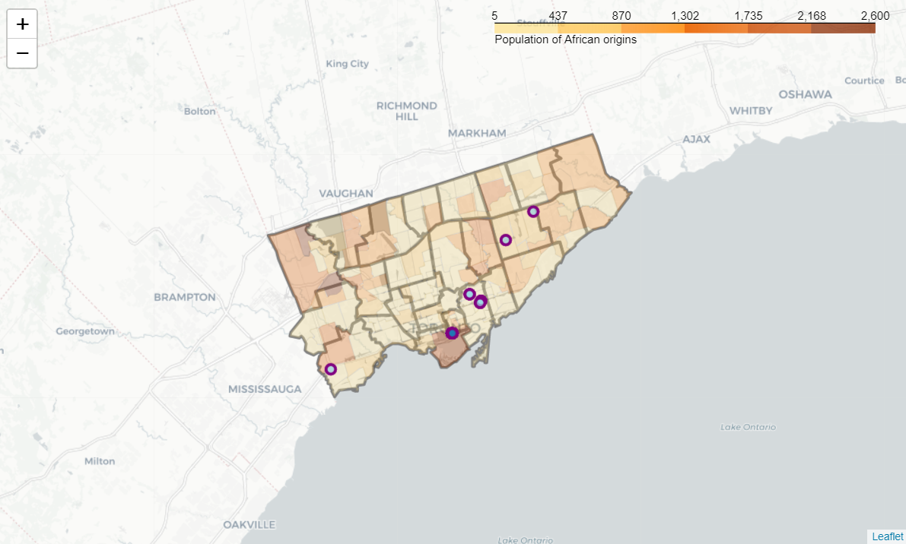
We can notice 3 locations that can be considered candidates to have a new successful Moroccan restaurant:
First Canadian Place, Underground city
Alderwood, Long Branch
Maryvale, Wexford

Slide 17
To conclude my analysis, I found 3 potential areas to open then Moroccan restaurant, however, that doesn't mean that you should open it right away, there exists multiple different factors that should be taken into consideration when opening a new business that are and not limited to : clients accessibility, land prices, rent prices, average revenue of restaurants in areas, business competitors and an optimal location.

Slide 18
THANK YOU !

